Slide 1


2025 AmeriFlux Annual Meeting
Code Snippet Sharing for Flux Research
Conveners: Xiangmin (Sam) Sun, Roel Ruzol, Yujie Liu, Angela Che Ing Tang, FLUXNET Early Career Network Committee

Slide 2
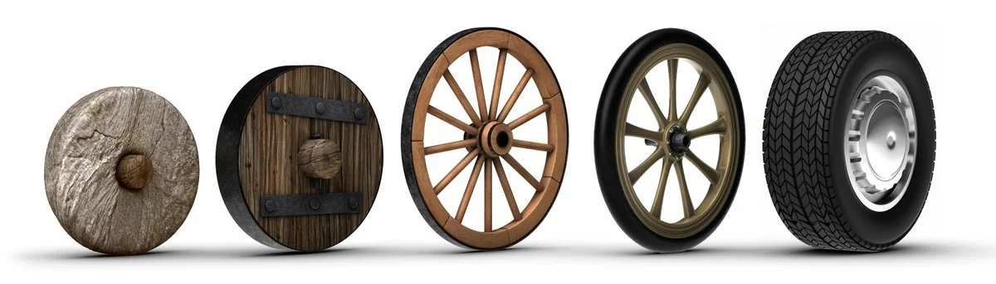
Don’t reinvent the wheel.
Just improve it.

Slide 3
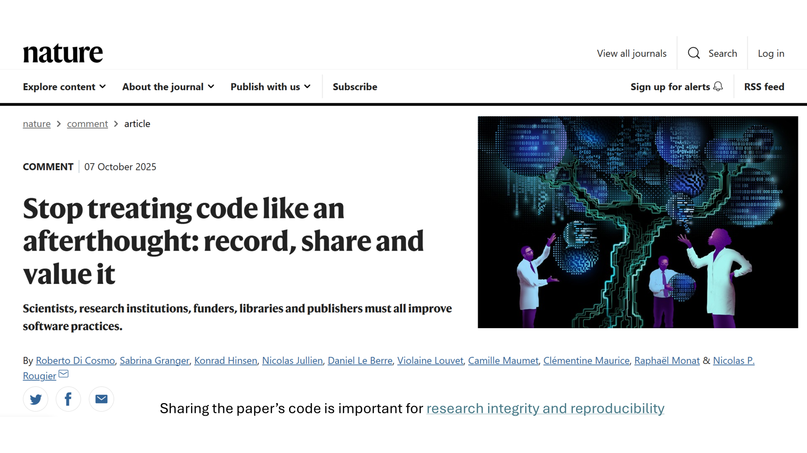

Slide 4



What is a code snippet ?
a small, reusable block (independent chunk) of code designed to perform a specific function.
The little things boosting a productivity.
General
Programming
Knowledge and
Skill Sets
Eddy Covariance
Flux research
Personalized
Code
snippet

Slide 5
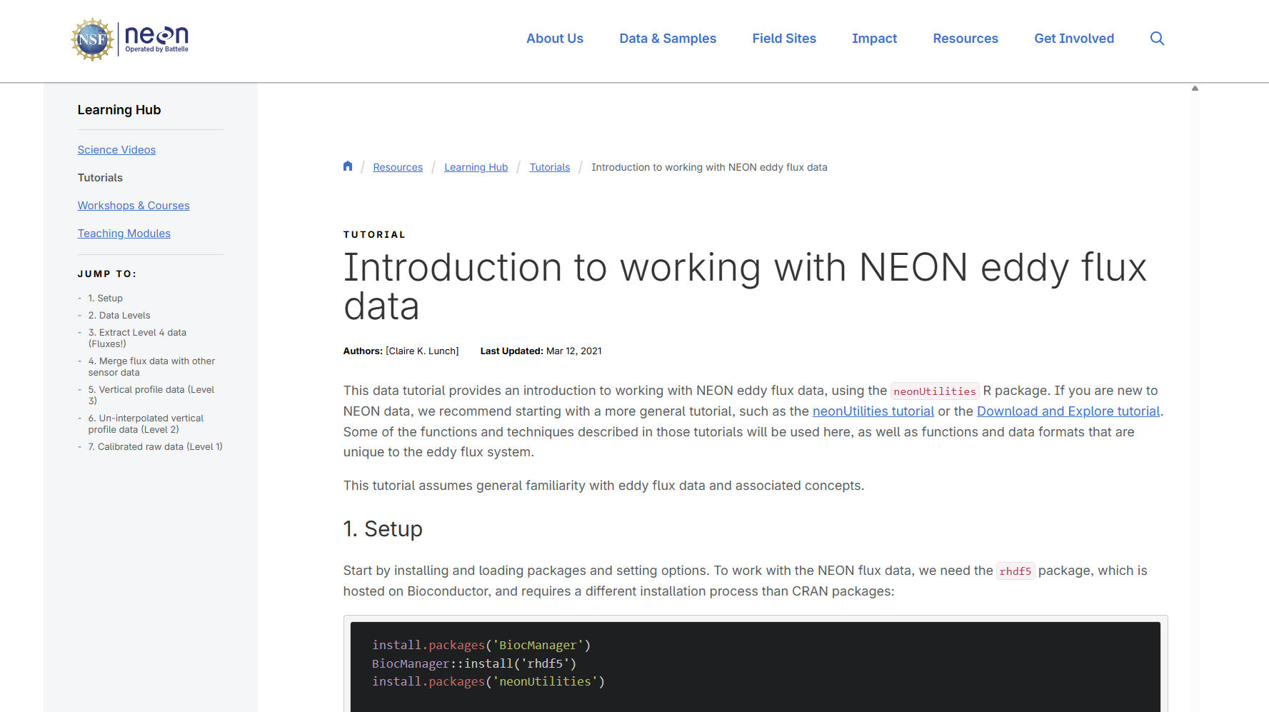
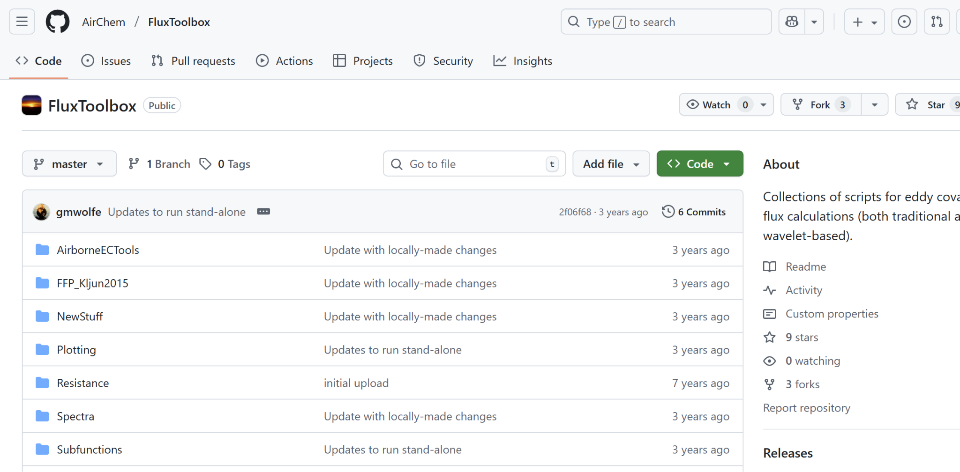
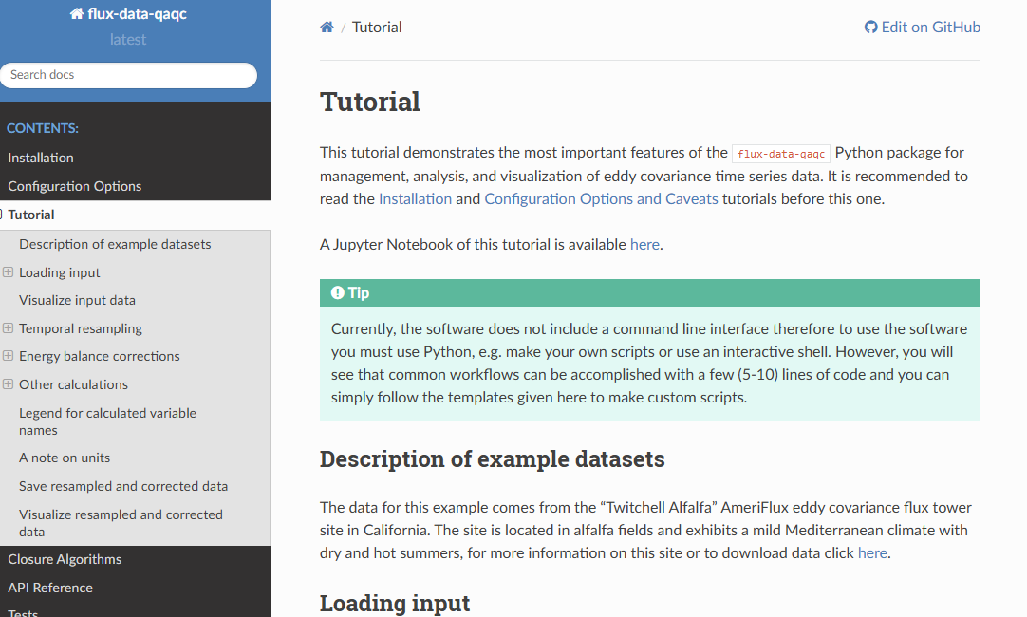
Some code snippet examples

Slide 6
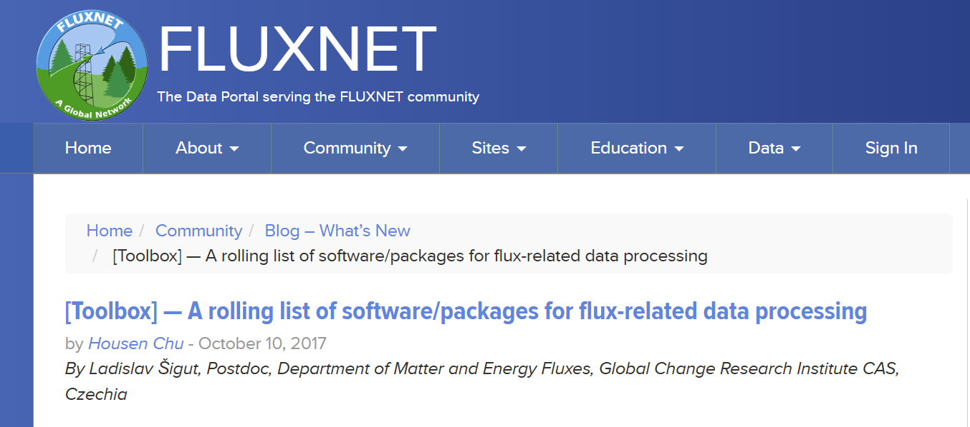

Toolbox available for Flux data processing
https://fluxnet.org/2017/10/10/toolbox-a-rolling-list-of-softwarepackages-for-flux-related-data-processing/

Slide 7
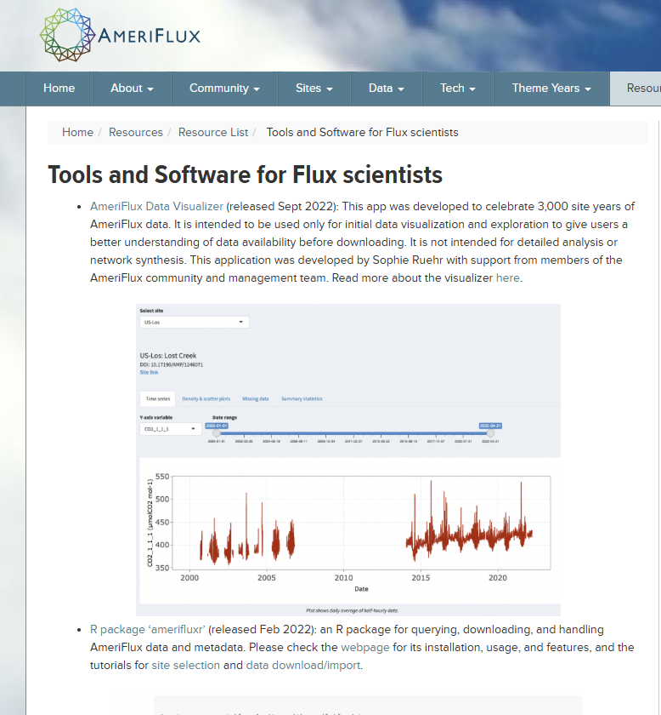

https://ameriflux.lbl.gov/resources/resource-list/tools-and-software-for-flux-scientists/

Slide 8

Processing tools
AmeriFlux BASE Flux/Met Data QA/QC and Processing
https://github.com/AMF-FLX/AMF-BASE-QAQC
Chu, H., Christianson, D.S., Cheah, YW. et al. AmeriFlux BASE data pipeline to support network growth and data sharing. Sci Data 10, 614 (2023). https://doi.org/10.1038/s41597-023-02531-2
ONEFlux (Open Network-Enabled Flux processing pipeline)⁺
https://github.com/fluxnet/ONEFlux
Pastorello, G., Trotta, C., Canfora, E. et al. The FLUXNET2015 dataset and the ONEFlux processing pipeline for eddy covariance data. Sci Data 7, 225 (2020). https://doi.org/10.1038/s41597-020-0534-3
+Jointly developed with ICOS and European Fluxes Database https://github.com/AMF-FLX
^{https://github.com/fluxnet}
Notes:
AmeriFlux Management Project data processing codes are open-source and released on Github. The codes are responsible for processing of all AmeriFlux sites’ flux-met data. The AMF-BASE-QAQC codebase is responsible for generating the BASE data product, while the ONEFlux codebase is used to generate the FLUXNET data product. ONEFlux is jointly developed with the international community, specifically ICOS and European Fluxes Database.

Slide 9
Data tools
AMF-UserTools (BIF File Parser)
https://github.com/AMF-FLX/AMF-UserTools
amerifluxr (R package)⁺
https://chuhousen.github.io/amerifluxr
Chu, Housen, and Hufkens, Koen. “amerifluxr v1.0.0.” Computer software. May 10, 2021. https://github.com/chuhousen/amerifluxr. https://doi.org/10.11578/dc.20210730.2.
AmeriFlux Data Visualizer
https://ameriflux.shinyapps.io/version1/
+Jointly developed Koen Hufkens https://ameriflux.lbl.gov/resources/resource-list/tools-and-software-for-flux-scientists/
Notes:
On this slide, there are a number of data tools that are hosted on AMP’s Github. Specifically, there is the BIF File Parser, which is a Jupyter notebook developed by Deb Agarwal. Next up, we have the R package amerifluxr that allows data users in the R environment to access AmeriFlux data and metadata through a programmatic interface in the R language. Lastly with a data visualization tool that is developed by Sophie Ruhr to help with initial data visualization and exploration to give users a better understanding of data availability before downloading.

Slide 10
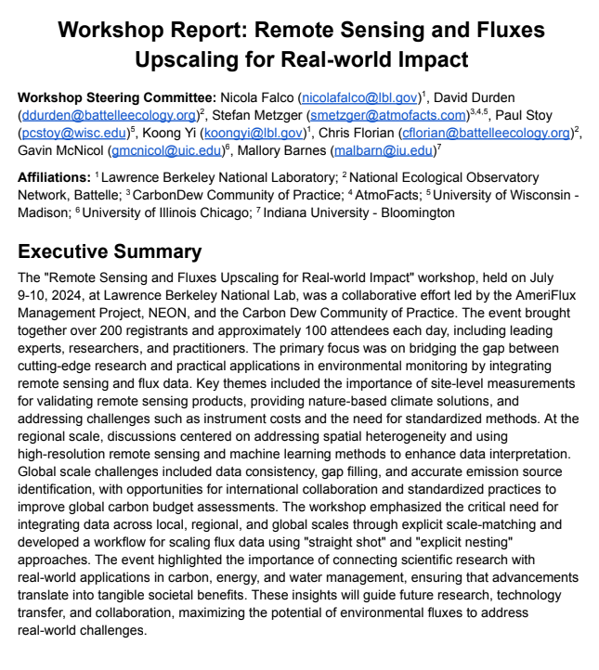
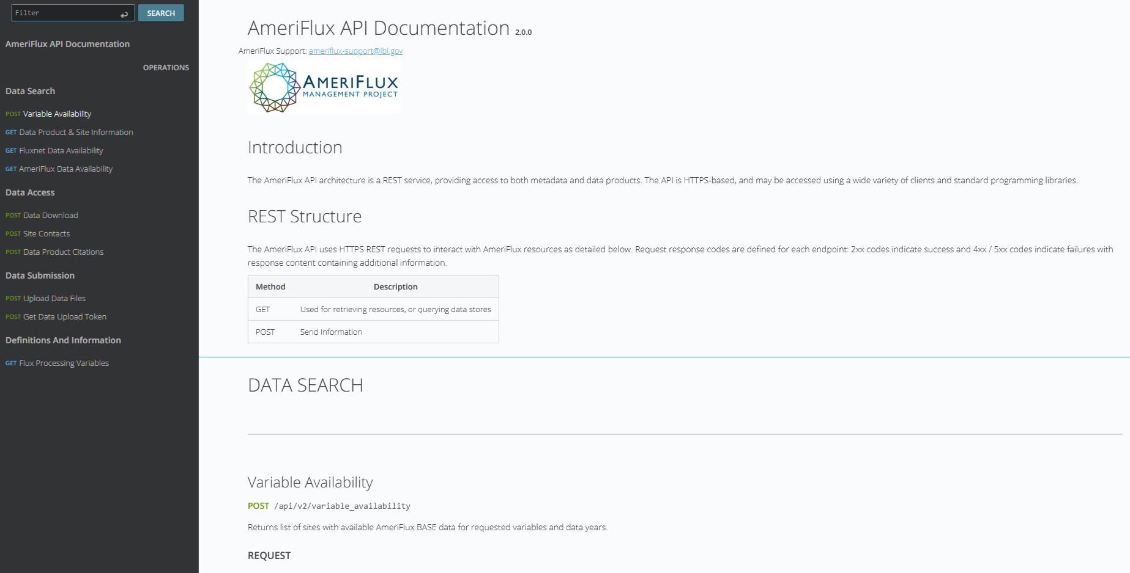
Community reports and APIs
Hands-on material from workshop
Flux upscaling working group: 2024 Workshop
https://github.com/AMF-FLX/Flux-upscaling-working-group-2024-Workshop-Report
AmeriFlux API documentation
https://amfcdn.lbl.gov/docs
Notes:
On this slide, we have the newly released Flux upscaling working group’s 2024 Workshop Report: Remote Sensing and Fluxes Upscaling for Real-world Impact report that is now hosted on Github. The repository features presentations from the workshop and Jupyter Notebooks to analyze and integrate remote sensing and flux data.
Lastly, AmeriFlux now has documentation on APIs that allow data users to interact with our systems in a programmatic manner.

Slide 11

Code snippet

Slide 12
Code snippet sharing examples
Snippet 1
Snippet 2
Snippet 3
Snippet 4
Getting planetary boundary layer height for Kljun’s FFP model
https://github.com/sunxm19/get_planetenary_layer_boundary_height_from_ERA5_for_FFP/blob/main/1_boundary_layer_era5.R

Slide 13

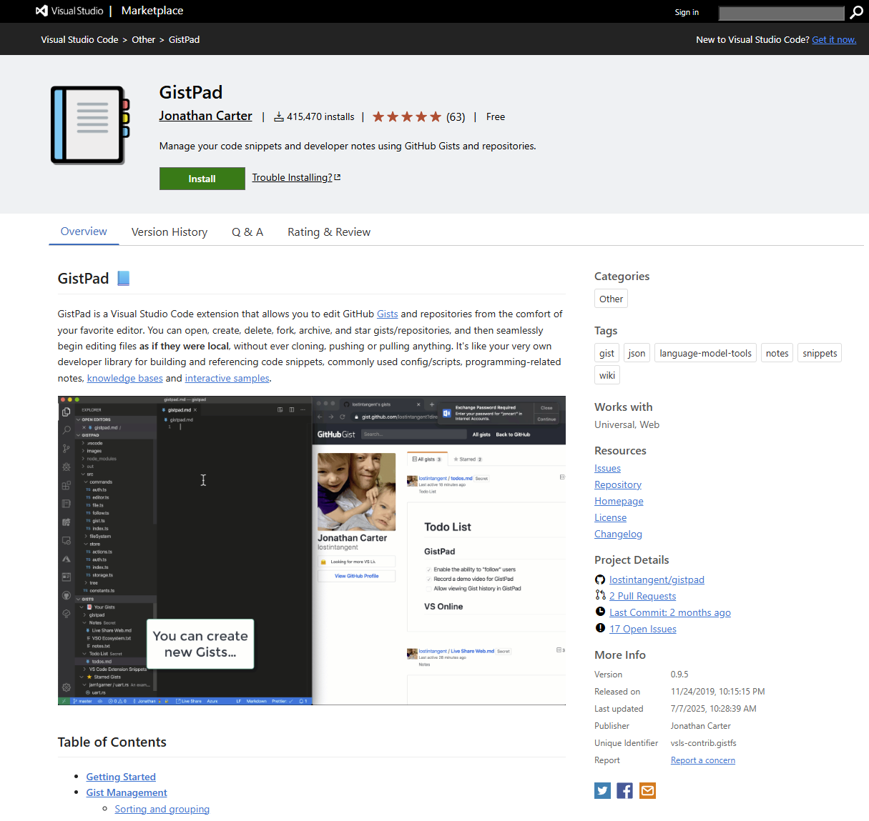

Platform for code sharing

Slide 14

Choices on programming languages

Slide 15
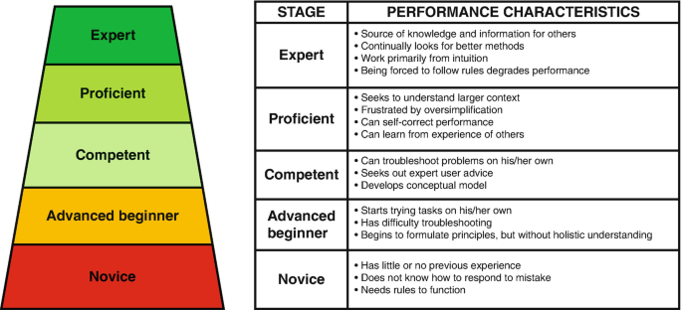

Slide 16
Which AI tool used for code debug?
ChatGPT
Claude AI
DeepSeek
Microsoft Copilot
Gemini
…

Slide 22
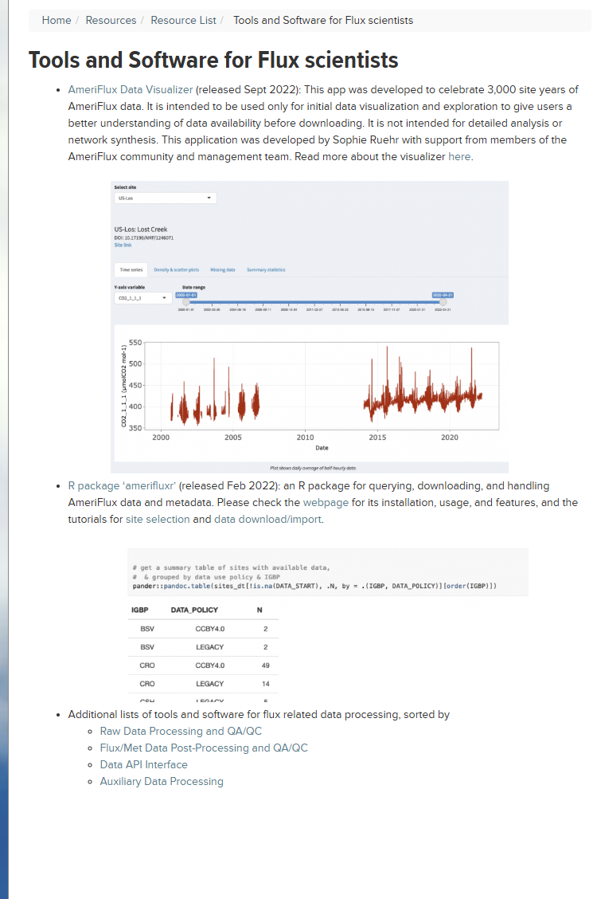

Slide 23

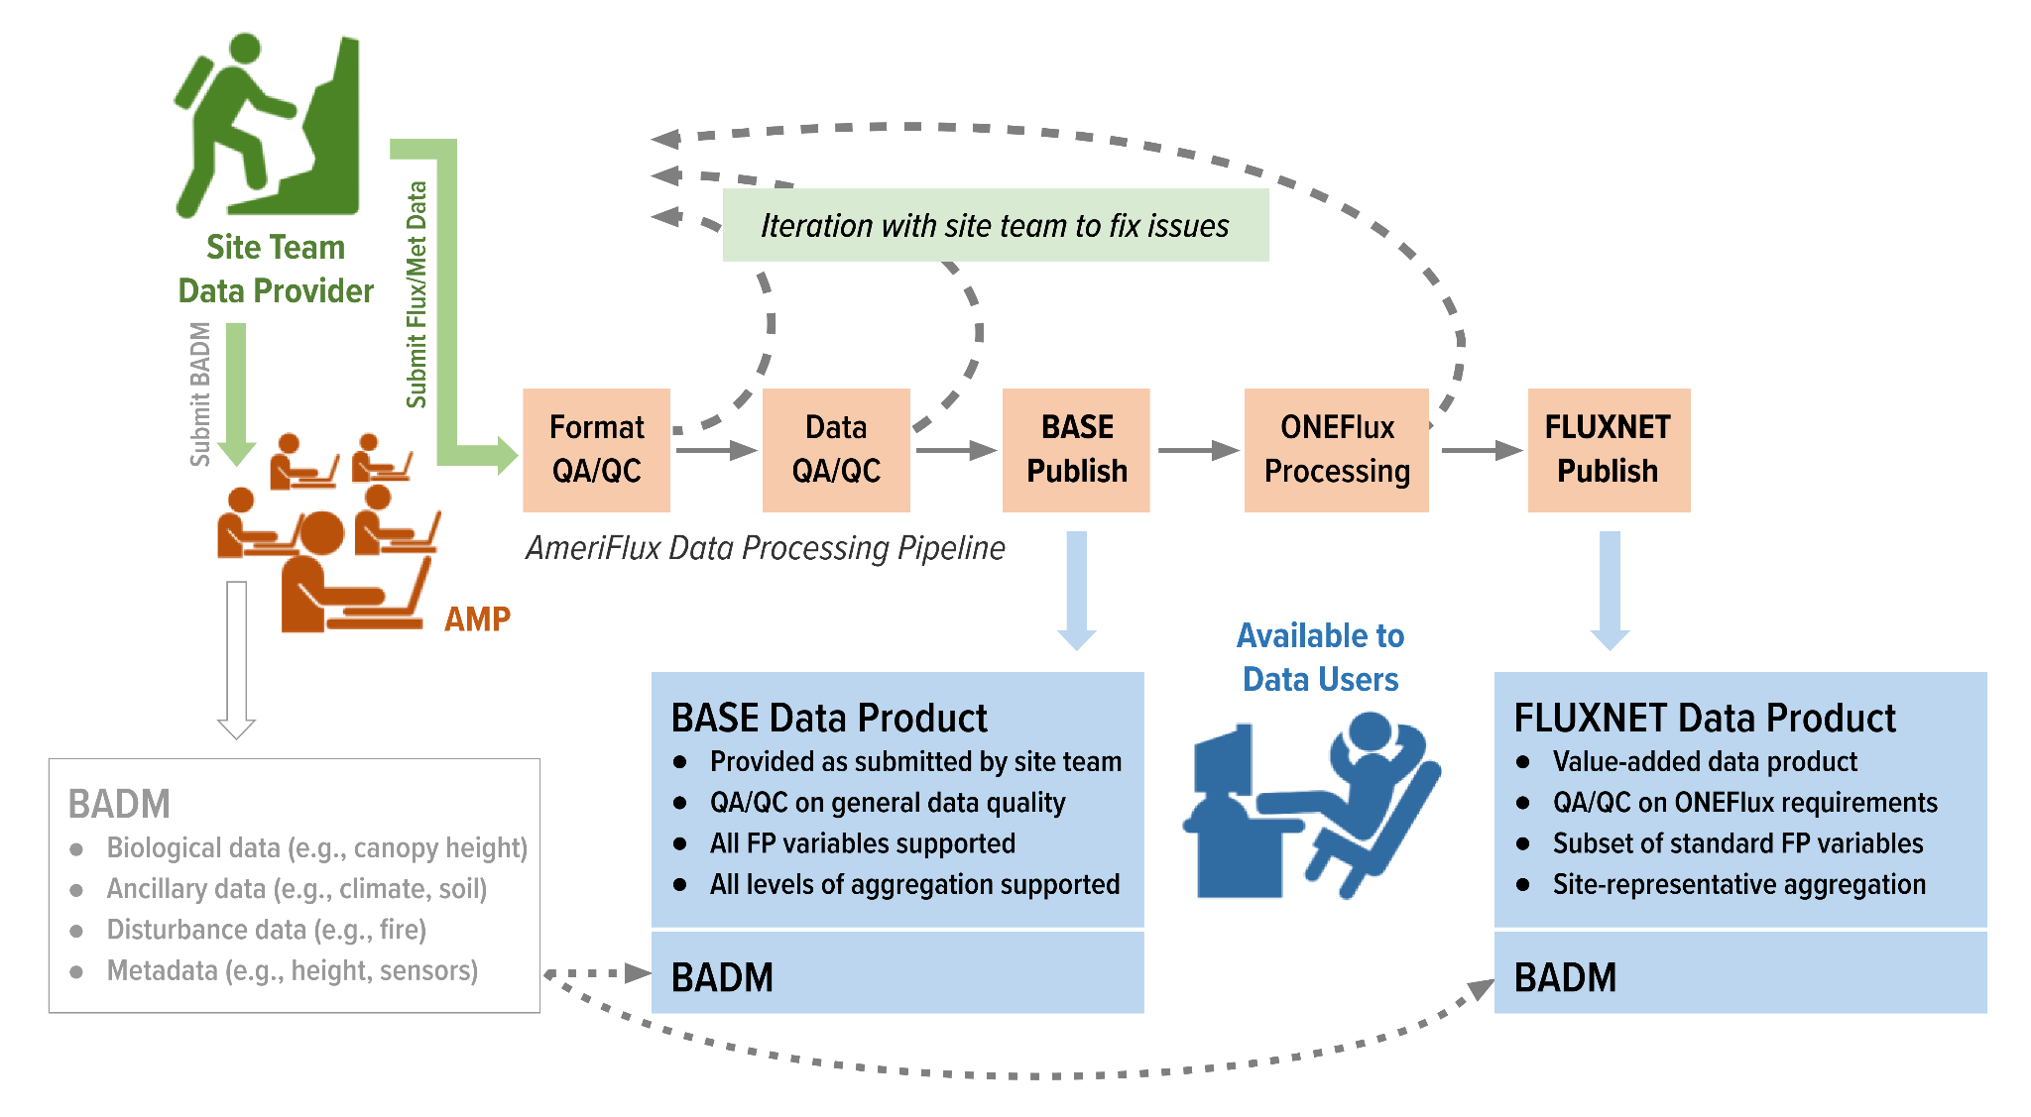
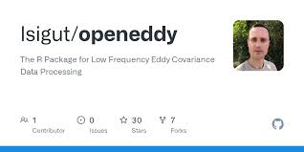
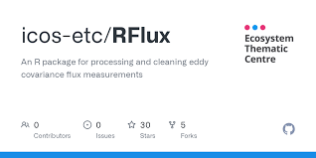

Slide 24
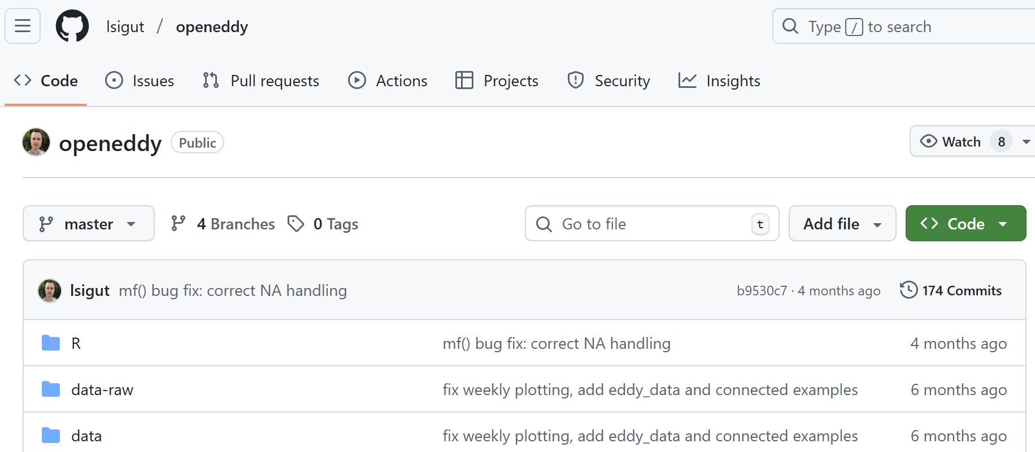
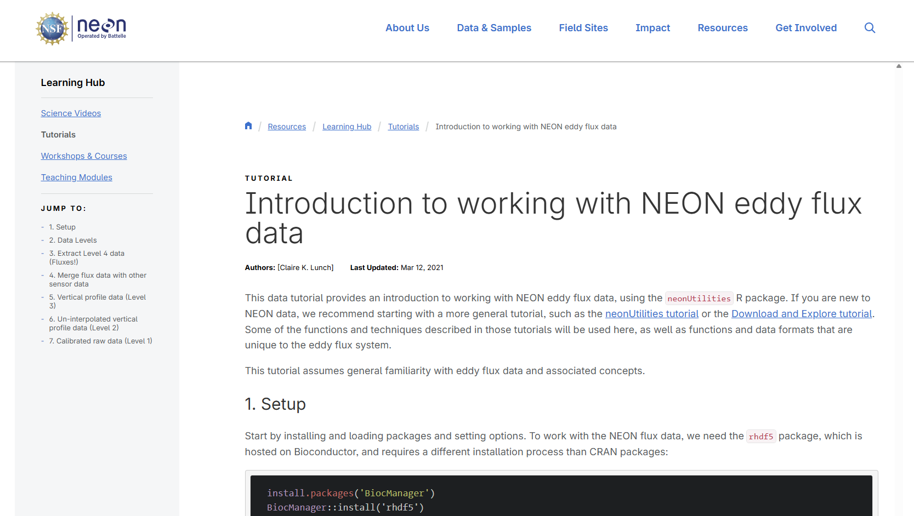
Learning materials

Slide 26
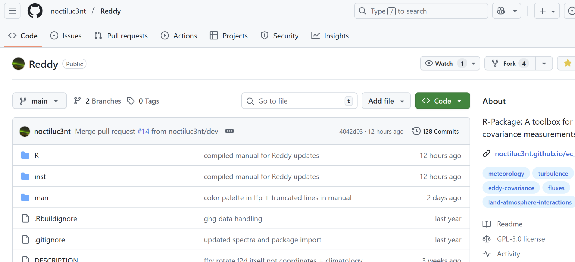

Slide 27
